Slide 1

Traffic Accident Hotspot Detection
Using HDBSCAN Clustering to identify accident-prone locations from geospatial crash data.
Group Members: Nicole Cherop · Danni Podho · Albert Ngotho · Trina Kinyua · Kian Muchemi

Slide 2

Introduction & Problem Statement
Background
Road traffic accidents are a major public safety concern, causing injuries, fatalities, and economic losses. Identifying accident-prone locations enables authorities to improve road safety, allocate resources effectively, and support informed decision-making.
The Problem
Analyzing thousands of accident records manually is difficult and time-consuming. This project applies the HDBSCAN machine learning clustering algorithm to automatically identify traffic accident hotspots using the geographical locations of crashes.

Slide 3
Project Objectives
General Objective: To identify traffic accident hotspots using the HDBSCAN clustering algorithm.
1
2
Collect & Preprocess
Clean & Validate
Collect and preprocess traffic crash data.
Clean and validate geographical coordinates.
3
4
Detect Hotspots
Visualize
Detect accident hotspots using HDBSCAN.
Visualize identified hotspots on an interactive map.

Slide 4
Dataset & Data Preprocessing
Source: Chicago Traffic Crashes Dataset
Preprocessing Steps
Key features include:
Filtered crashes from 2024 onwards
Crash Date
Latitude & Longitude
Weather & Lighting Conditions
Posted Speed Limit
Crash Type & Injury Information
Removed records with missing or invalid coordinates
Converted dates to datetime format
Converted GPS to UTM projection for accurate distance calculations

Slide 5
Methodology
The project follows a structured workflow from raw crash data through preprocessing, clustering, and visualization to produce actionable hotspot maps.
01
02
03
Traffic Crash Dataset
Data Cleaning
Coordinate Validation
04
05
06
GeoDataFrame Creation
HDBSCAN Clustering
Hotspot Identification
07
Interactive Map Visualization
Why HDBSCAN?
Does not require specifying the number of clusters
Detects clusters of varying densities
Identifies isolated crashes as noise
Suitable for large geospatial datasets

Slide 6

MACHINE LEARNING MODEL
HDBSCAN Clustering
Parameters Used
min_samples = 15
min_cluster_size = 100
Distance Metric = Euclidean
Output
Each accident is assigned to a cluster
Cluster -1 represents isolated crashes (noise)
All other clusters represent accident hotspots

Slide 7
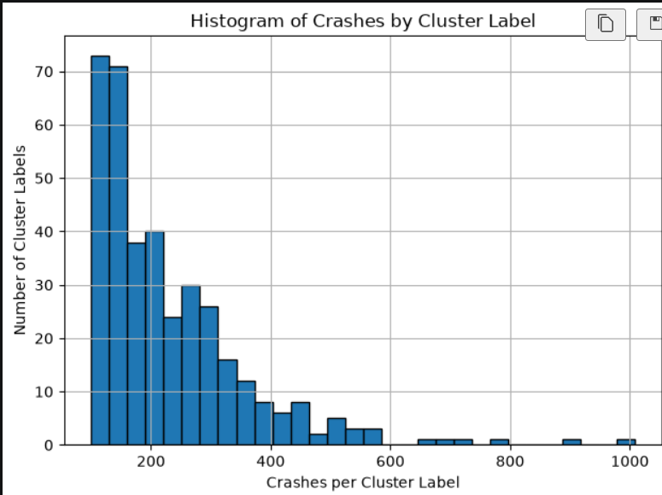

Clustering Results
371
Hotspots Identified
Approximately 371 accident hotspots detected across the dataset.
1,009
Largest Hotspot
The largest hotspot contained 1,009 crashes.
229
Average Hotspot Size
Average hotspot size was about 229 crashes.
55,601
Isolated Incidents
55,601 crashes were classified as isolated incidents (noise).
Large clusters represent areas with consistently high crash frequencies, while noise points represent isolated accidents.

Slide 8
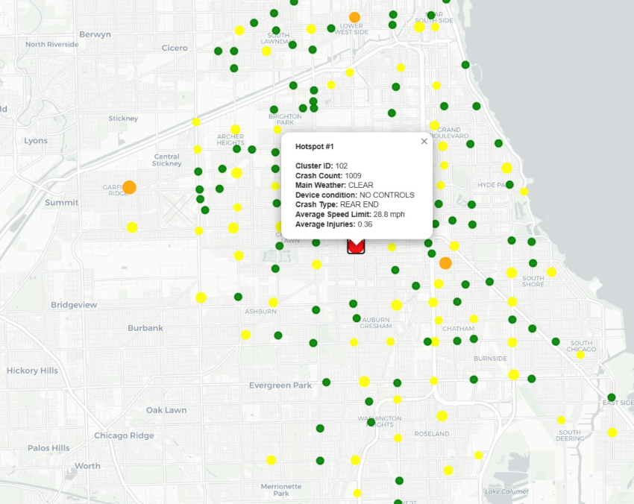
Accident Hotspot Visualization
Map Interpretation
Colored Points
Each color represents a different accident hotspot cluster.
Grey Points
Grey points represent isolated crashes classified as noise.
High Concentrations
The map clearly highlights areas with high accident concentrations.

Slide 9


Conclusion
Successful Detection
HDBSCAN successfully identified accident hotspots from over 140,000 traffic crash records.
Clear Distinction
The model distinguished dense accident regions from isolated crashes.
Actionable Insights
Interactive visualization improved interpretation of results. Findings can support road safety planning and urban decision-making.
Thank You! Questions & Discussion welcome.

